Slide 1
Informatik E1 Abels

Slide 2
Wie erstelle ich in CSS mit einer Flexbox ein Layout?

Slide 3
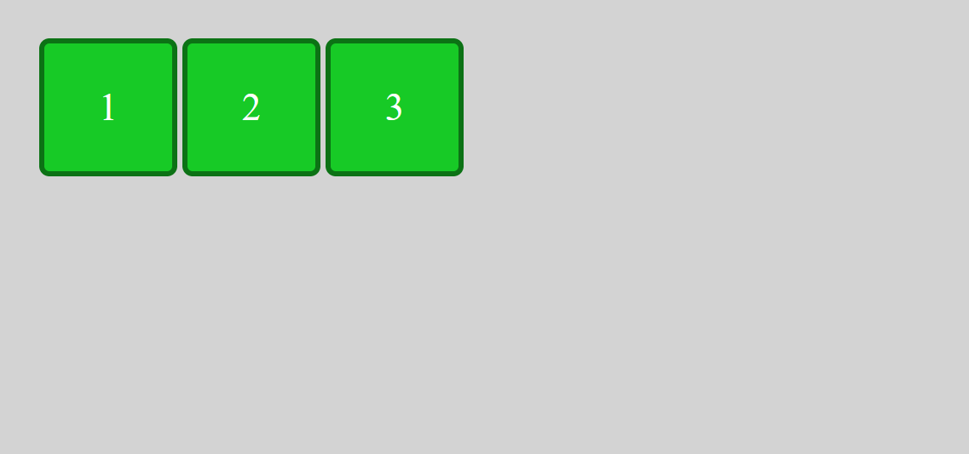
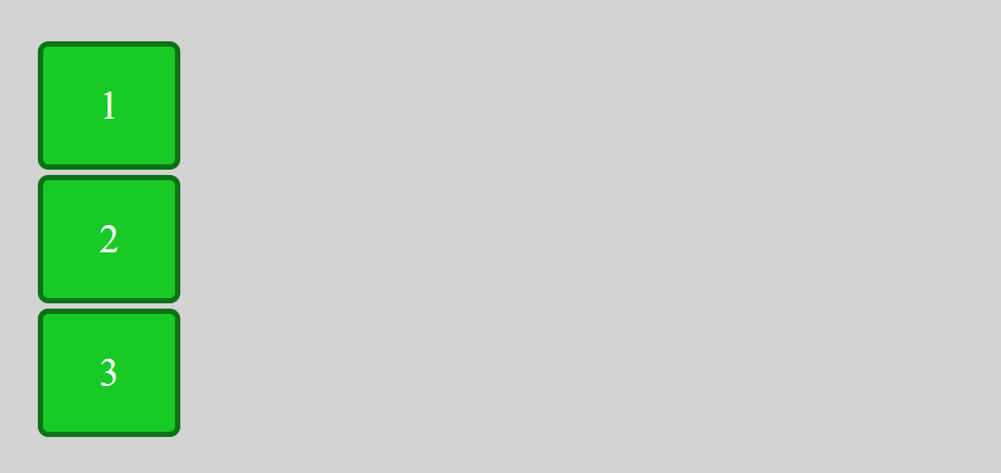
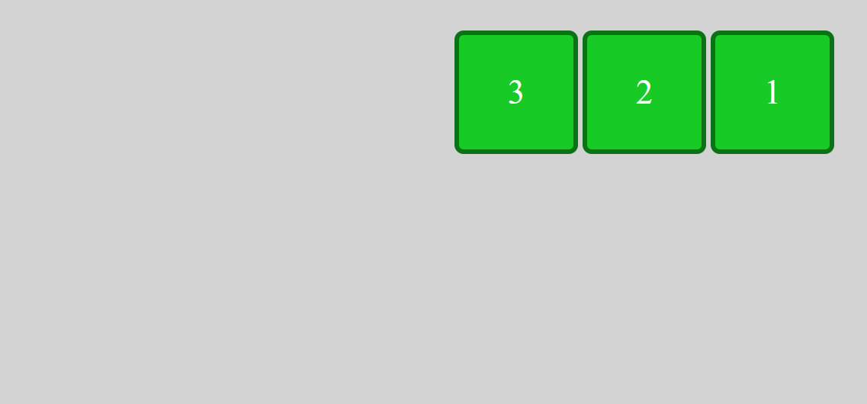
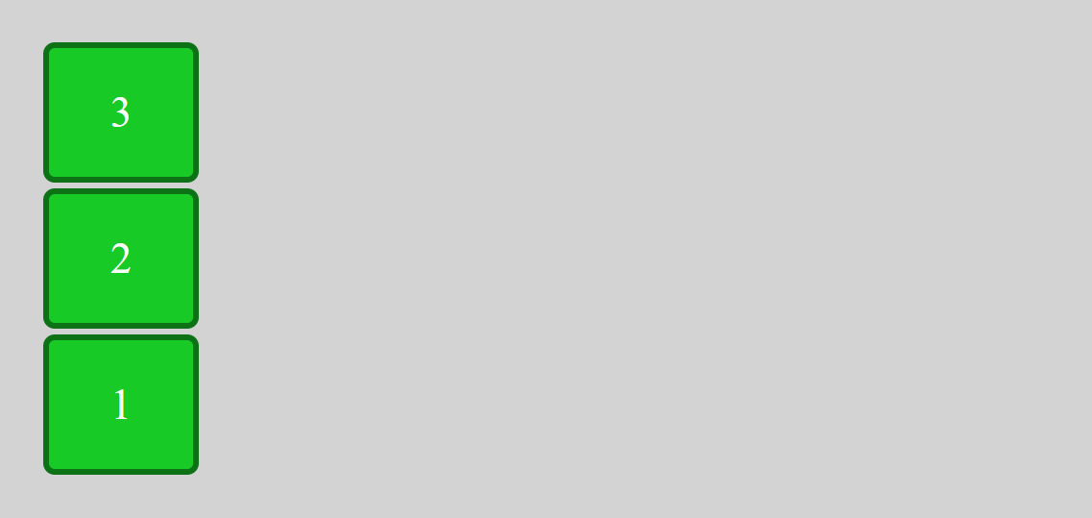
Flexbox
flex-direction
<div class="flexbox">
<div class="item">1</div>
<div class="item">2</div>
<div class="item">3</div>
</div>
.flexbox {
display: flex;
flex-direction: row;
}
row
column
row-reverse
column-reverse

Slide 4
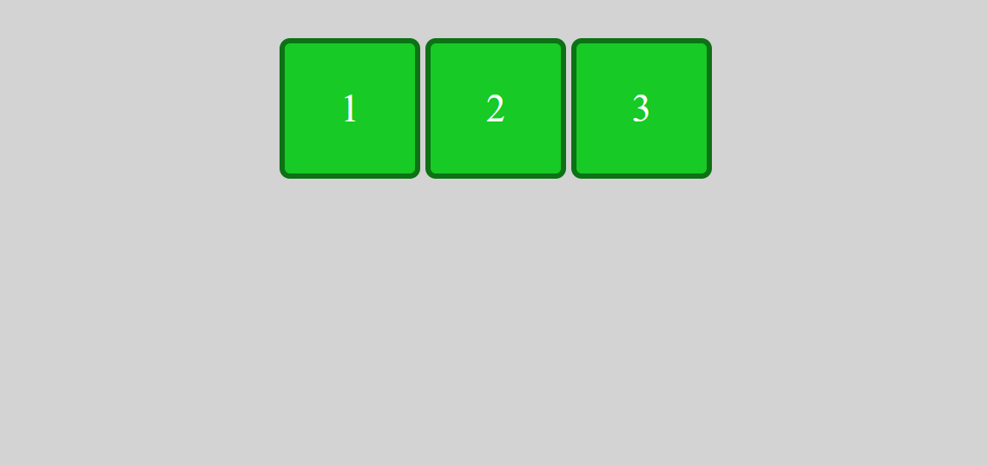
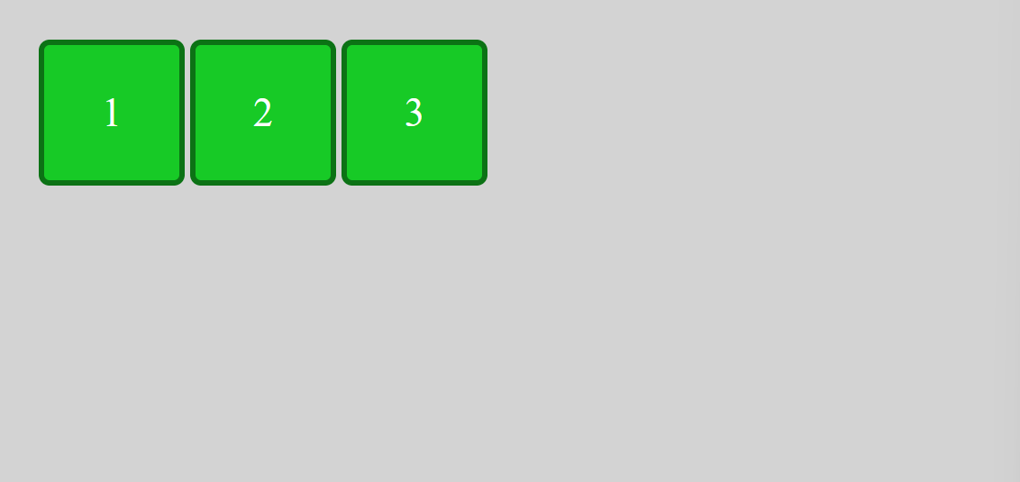
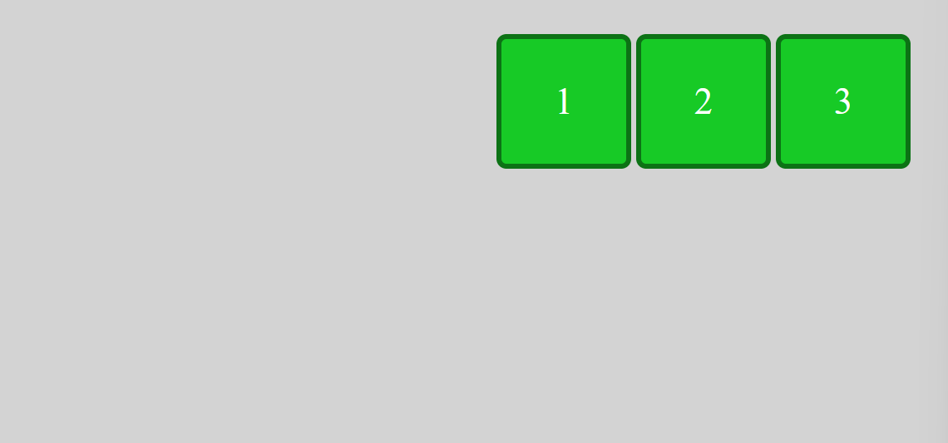
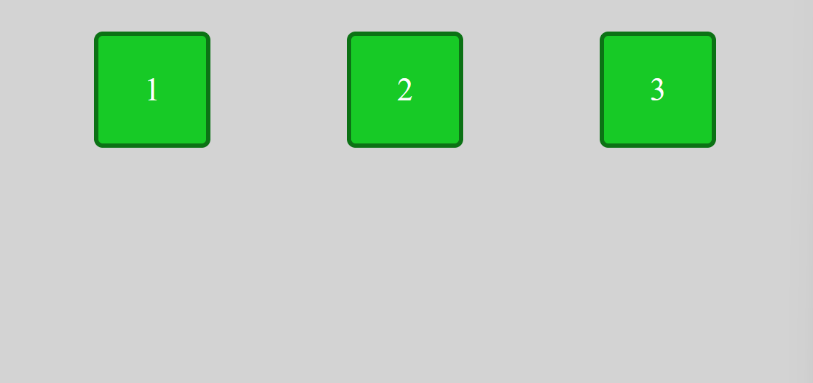
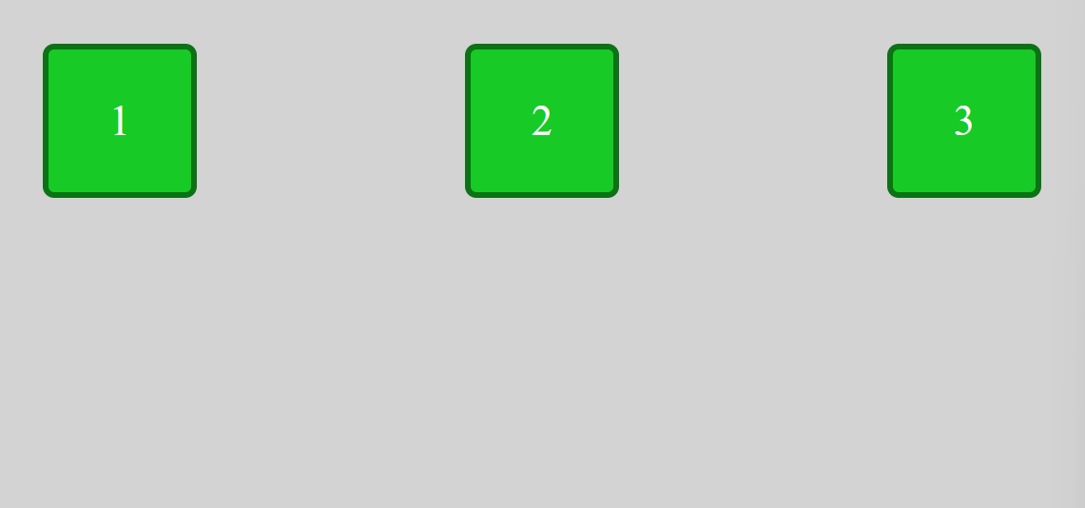
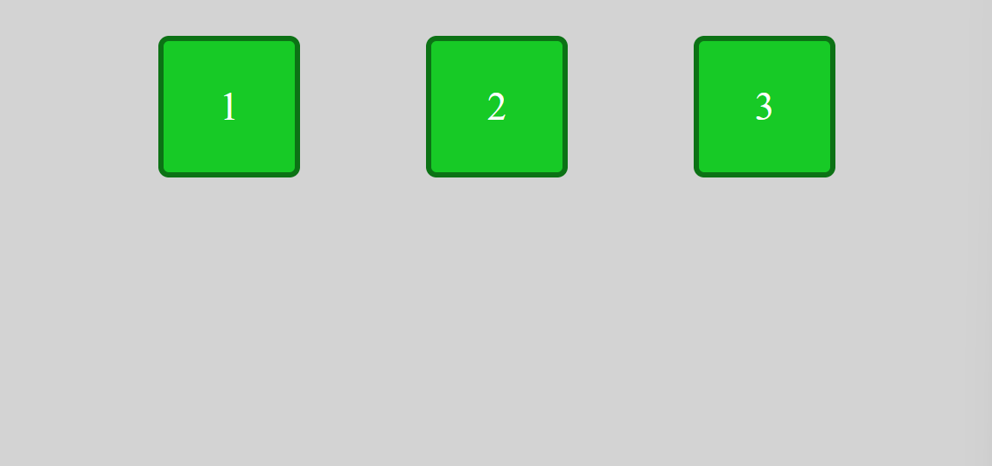
Flexbox
justify-content
<div class="flexbox">
<div class="item">1</div>
<div class="item">2</div>
<div class="item">3</div>
</div>
.flexbox {
display: flex;
justify-content: center;
}
center
start
end
space-around
space-between
space-evenly

Slide 5
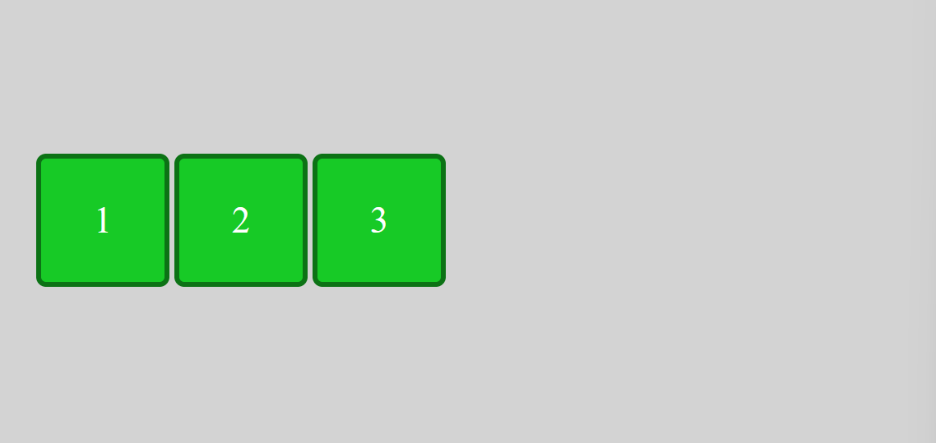

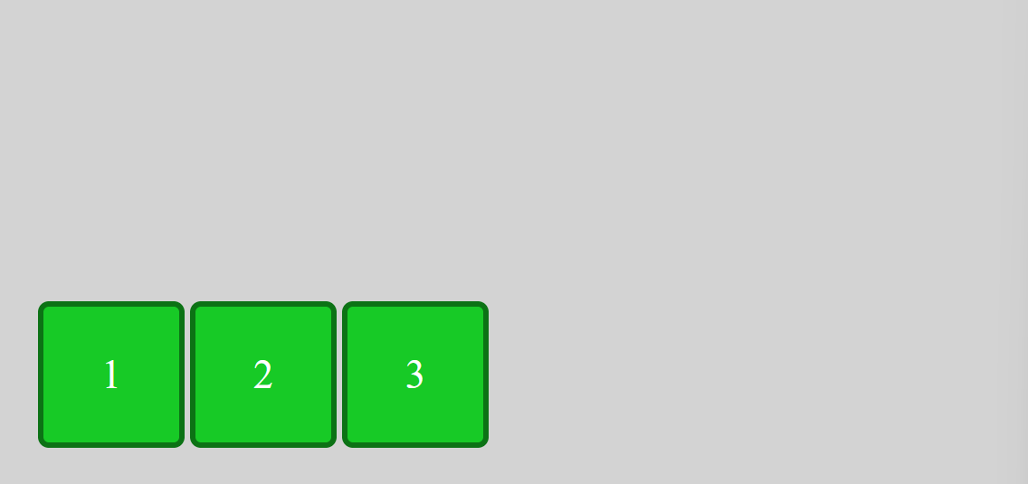
Flexbox
align-items
<div class="flexbox">
<div class="item">1</div>
<div class="item">2</div>
<div class="item">3</div>
</div>
.flexbox {
display: flex;
align-items: center;
}
center
start
end

Slide 6
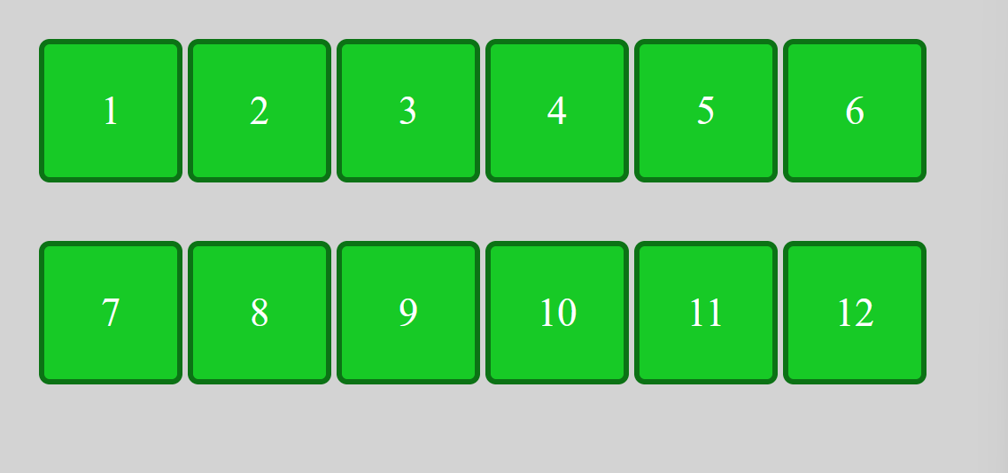
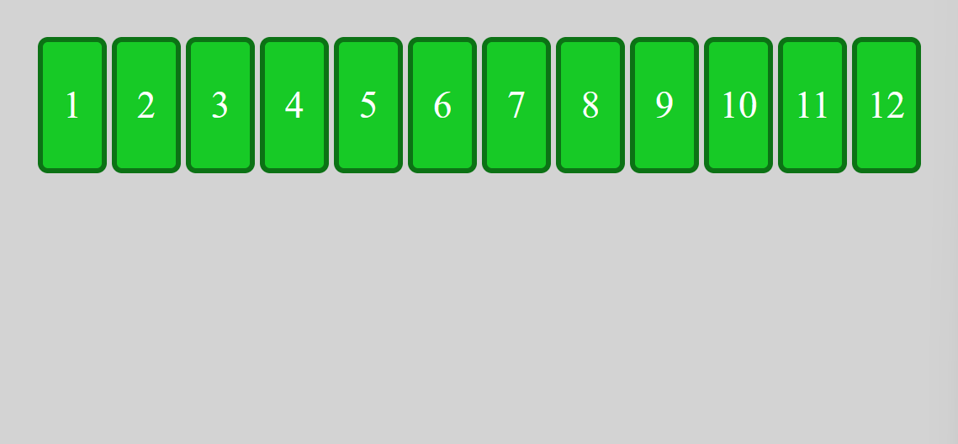
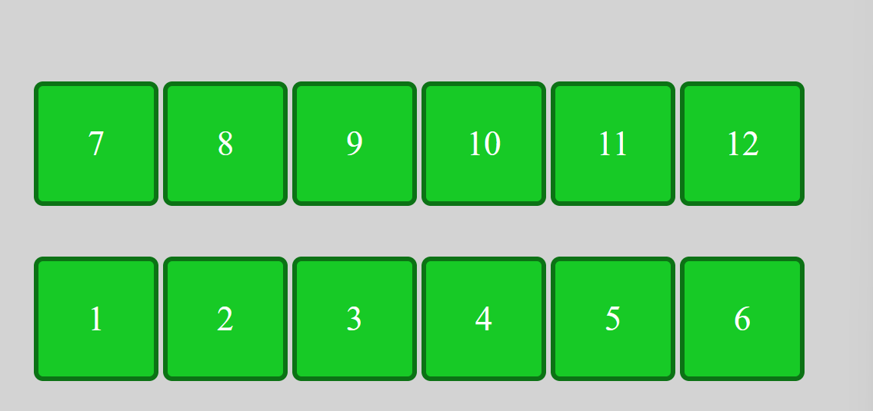
Flexbox
flex-wrap
<div class="flexbox">
<div class="item">1</div>
<div class="item">2</div>
<div class="item">3</div>
<div class="item">4</div>
<div class="item">5</div>
<div class="item">6</div>
<div class="item">7</div>
<div class="item">8</div>
<div class="item">9</div>
<div class="item">10</div>
<div class="item">11</div>
<div class="item">12</div>
</div>
wrap
.flexbox {
display: flex;
flex-wrap: wrap;
}
nowrap
wrap-reverse

Slide 7
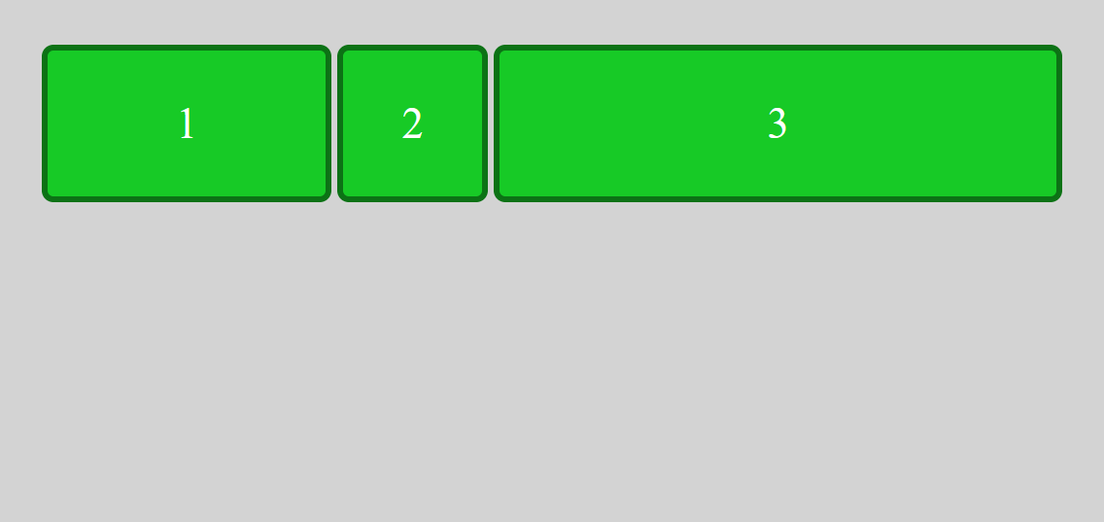
Flexbox
flex
<div class="flexbox">
<div class="item first">1</div>
<div class="item second">2</div>
<div class="item third">3</div>
</div>
.flexbox {
display: flex;
}
.item.first {
flex: 2;
}
.item.second {
flex: 1;
}
.item.third {
flex: 4;
}
2 / 7
1 / 7
4 / 7

Slide 8
Flexbox
order

Slide 9
Flexbox
align-self

Slide 10
Flexbox
flex-flow

Slide 11
Flexbox
align-content

Slide 12


Übung 1
Löse alle Rätsel auf folgender Website: https://flexboxfroggy.com/

Slide 13
Flexbox

Slide 14
Erstelle drei Websites namens navbar1.html, navbar2.html, navbar3.html in denen verschiedene Menüs dargestellt werden (horizontal, vertikal, zentriert, …).
<div class="navbar">
<a class="navitem" href="home.html">Home</a>
<a class="navitem" href="product.html">Product</a>
<a class="navitem" href="about.html">About</a>
<a class="navitem" href="contact.html">Contact</a>
</div>

