Slide 1
Informatik E1 Abels

Slide 2
Was ist ein Block -Level bzw. Inline -Level Element?

Slide 3
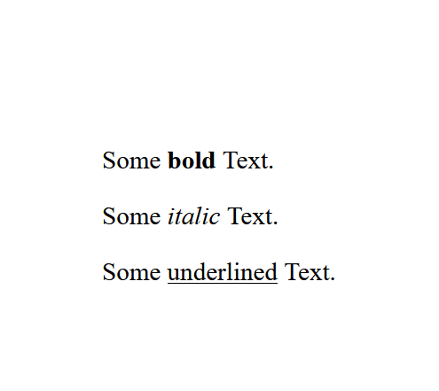
Block vs Inline
<article> <div> <figure> <footer> <form> <h1>-<h6> <header> <li> <main> <nav> <ol> <p> <table> <ul> <video>
<a> <b> <br> <button> <code> <i> <img> <input> <label> <select> <span> <textarea>
Inline-level elements take up as much width as necessary
index.html
<p>Some <b>bold</b> Text.</p><p>Some <i>italic</i> Text.</p><p>Some <u>underlined</u> text.</p>
block-level elements start on a new line and take up the full width available

Slide 4
Block vs Inline
<article> <div> <figure> <footer> <form> <h1>-<h6> <header> <li> <main> <nav> <ol> <p> <table> <ul> <video>
<a> <b> <br> <button> <code> <i> <img> <input> <label> <select> <span> <textarea>
index.html
<p>Some <b>bold</b> Text.</p>
<div>Some <span style=“font-weight: bold;”>bold</span> Text.</div>

Slide 5
<div> vs <span>
<div style="background-color: darkgreen; color: white; padding: 20px;">
<h1>Quote</h1>
<p>The future belongs to those who believe in the beauty of their dreams.</p>
</div>
<p>by <span style="font-weight: bold; color: red;">Eleanor Roosevelt</span></p>
index.html

Slide 6
<div> vs <span>
<div class="quote">
<h1>Quote</h1>
<p>The future belongs to those who believe in the beauty of their dreams.</p>
</div>
<p>by <span id="author">Eleanor Roosevelt</span></p>
.quote {
background-color: darkgreen;
color: white;
padding: 20px;
}
#author {
font-weight: bold;
color: red;
}
index.html

Slide 7
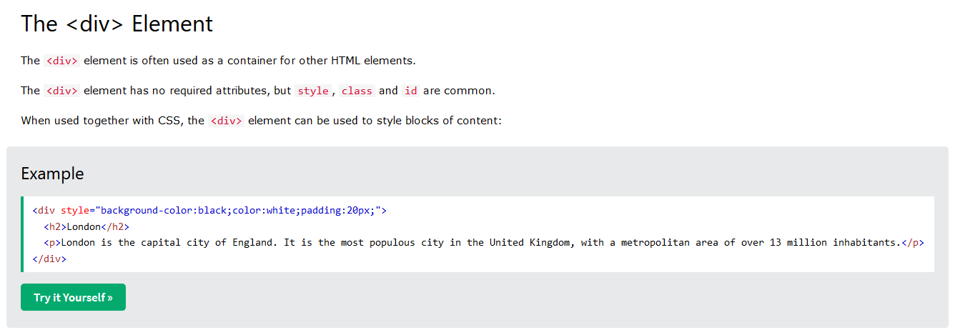
Übung 1
Erstelle eine Website TheDIV.html nach folgender Vorlage.
Elemente: div, span, p, h1, h3
Properties: color, background-color, font-family, padding

Slide 8
Block-Level
Inline-Level
div
span

Slide 9
Erweitere deine Website book.html um die neu erlernten Elemente und Properties.

